Slide 1
Basic Qualitative Strategies
Cap Peck, 1991

Slide 2
Research Question
Beginning with less specific research questions
Start with interests and a sense of the research situation
Study designs (including the research question) emerge

Slide 3
Sampling
Participants are identified for the information they may contribute.
Sampling purposes
Based on the types of information you need

Slide 4
Data Collection
Observations
Separate descriptions from interpretations
Interviews
Informants provide descriptions of culture and experience
Grand tour questions

Slide 5
Data Analysis
Done as data are collected in the study
Conceptualizing themes for sorting
Constant comparative
Memos
Theoretical notes
Methodological notes
Analytic memos

Slide 6
Trustworthiness
Quantitative Reliability
The degree to which data gathering remains consistent over different iterations or time.
Quantitative Validity
The degree to which you can defend what you think you found as what was really there.
Qualitative reliability and validity are based on the degree to which a study is trustworthy.

Slide 7
Credibility
Data gathering is:
Prolonged
Persistent
Triangulated
Peer briefing
Negative case analysis
Referential adequacy
Member checks

Slide 8
Transferability
Context bound description
External validity
Thick description
Context
Observation and interview

Slide 9
Audit Trails (Methods)
Dependability
Stability of the data
Confirmability
Neutrality of the data
The reflexive journal
Tracking biases and assumptions

Slide 10
Presenting Findings
Case study description
Pre-assigned coding systems
Emergent themes
Levels of abstraction
Exemplars
Diagramming relationships

Slide 11
Hermeneutics
The importance of context in understanding
Habermas
Control (Clarification of causal relationships)
Communication (Establishing understanding among actors)
Emancipation (Transforming the givens)
Why talk about this?

Slide 12
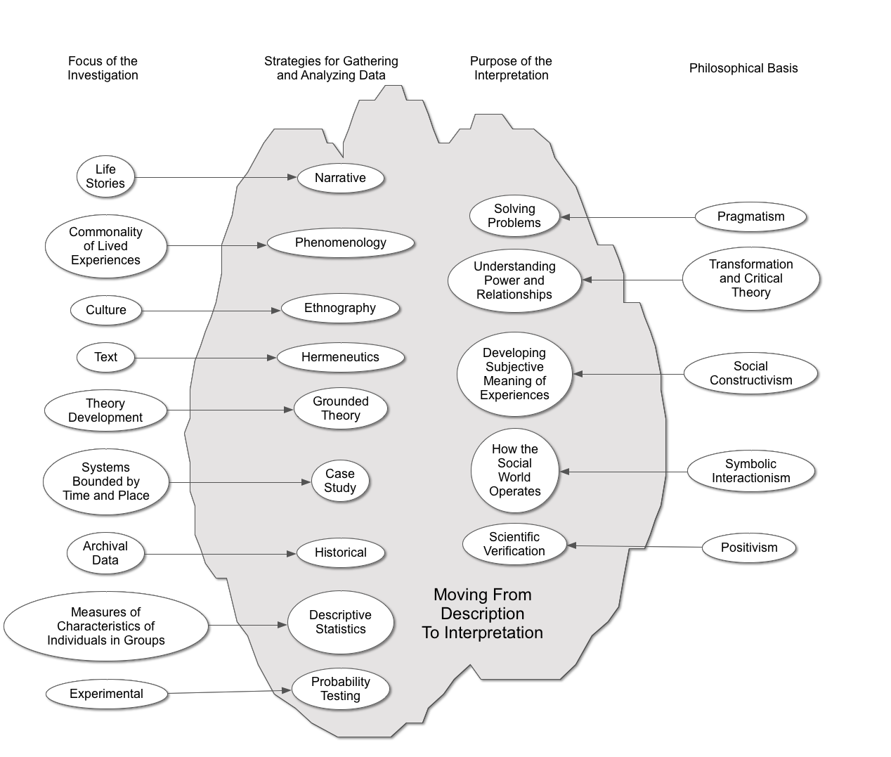
Mixed Methods

Slide 13
The Transition to Quantitative Creswell and Mixed Methods Design
Where do they over lap?
What do you need to know to use mixed methods?
Study designs
Exploratory—Using qualitative methods to design quantitative data collection
Explanatory—Using qualitative methods to enhance a quantitative explanation
Triangulation—Using both: quantitative methods to enhance a qualitative explanation

Slide 14
Qualitative Validity (Trustworthiness)

Slide 15
Validity
Research is valid when it is an accurate and generalizable description of the phenomenon being investigated.
Generalizable beyond the study sample
Accurate
The study design and execution do not impact the results

Slide 16
Validity
Research is valid when it is an accurate and generalizable description of the phenomena being investigated.
Over the history of research we have adopted rules to establish validity of research.
Follow the rules and you will have valid research.

Slide 17
Reliability and Validity
The language for this is from the quantitative tradition—scientific verification—positivism. Habermas’ cognitive interest of control.
In experimental research terminology:
Can we assume that the treatment (independent variable) is the only cause of change in the thing being measured (dependent variable)?

Slide 19
Read Walcott
Pay attention to how he attends to issues of validity in his work.

