Slide 1
Validity
When is research valid?

Slide 2
Validity
Over the history of research we have adopted rules to establish validity of research.
In quantitative research this is done in part by controlling the quality of the tools used to gather data.
In qualitative research you are the data gathering tool.
How do you account for yourself in the pursuit of validity?

Slide 3
Positionality
I see what I am disposed to see.
When I see something it means that I do not see other things. (figure/ground)

Slide 4
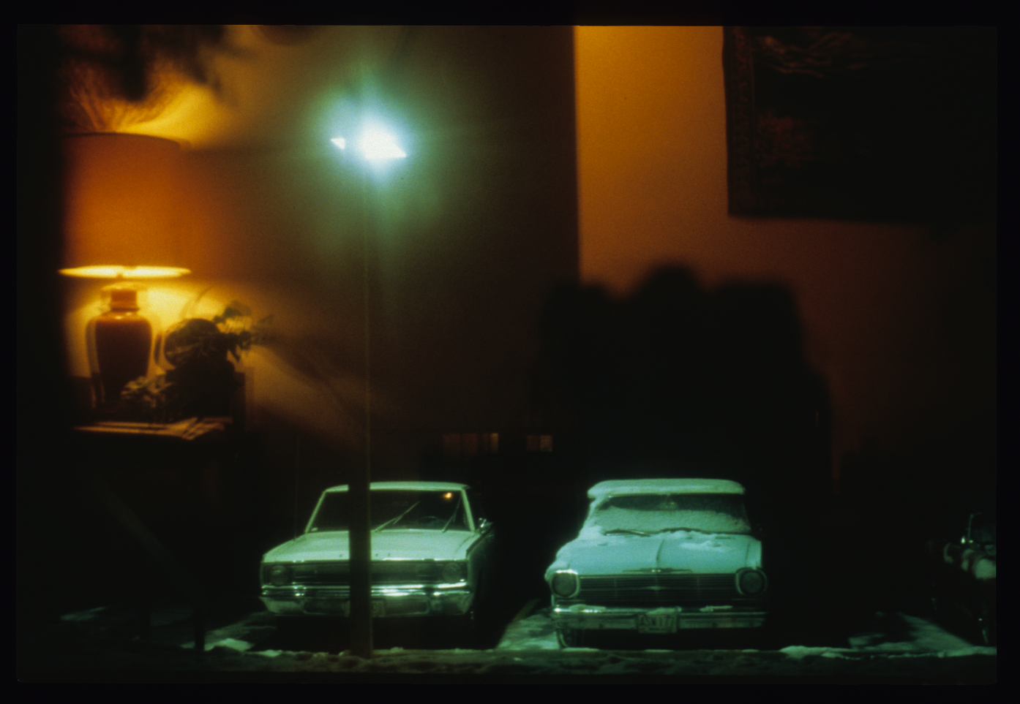

Slide 5
The Influence of Positionality
These things are particularly true for qualitative research because there are fewer controls on validity than quantitative.
Research design
Data gathering
Analysis

Slide 6
With Positionality in Mind:
Observation
Systematic Data Collection Approach

Slide 7
Characteristics of Observation
Prolonged engagement in a setting or social situation in order to:
  describe objects, events, and interactions
  become oriented to the situation so that the context is appreciated and understood
  be able to detect and account for distortions that might be in the data
  rise above your own preconceptions
  build trust

Slide 8
Characteristics of Observation
Clearly expressed, self-conscious notations of how observing is done
  Positionality (Biases)
  Researcher impact
  Ethics

Slide 9
Characteristics of Observation
Clearly expressed, self-conscious notations of how observing is done
  Positionality (Biases)
  Researcher impact
  Ethics

Slide 10
Observation
Researcher

Slide 11
Observation
When does researcher proximity affect the behavior of those observed?
Researcher
When does observation
become participant observation?

Slide 12
Characteristics of Observation
Clearly expressed, self-conscious notations of how observing is done
  Positionality (Biases)
  Researcher impact
    Recording observations
    Prolonged engagement
  Ethics

Slide 13
Characteristics of Observation
Clearly expressed, self-conscious notations of how observing is done
  Positionality (Biases)
  Researcher impact
    Recording observations
    Prolonged engagement
  Ethics
    DO NO HARM!

Slide 14
Characteristics of Observation
Methodical and tactical improvisation in order to develop a full understanding of the setting of interest

Slide 15
Characteristics of Observation
Imparting attention in ways that are in some sense standardized
  Observing something specific
    Driven by the problem statement
    Driven by prior observation
  Observing from a model
    Using a pre-existing coding structure

Slide 16
A brief side trip (once again) to theoretical frameworks

Slide 17
Study Progress
Some problem exists that you think is worth studying. You write a purpose statement to say exactly what you want to study.
You decide on the meaning of what you found.
You find out what others already know about this problem.
You report on what you found.
You design some way to gather and analyze evidence.

Slide 18
Problems
The problem with this model is that there is no way to predict if this work is a personal adventure or if it will help all of us understand the issue under investigation better.
Is this an opinion or is it substantiated reasoning?
The way to solve this is to use a theoretical framework.

Slide 19
Some problem exists that you think is worth studying. You write a purpose statement to say exactly what you want to study.
You decide on the meaning of what you found.
You find out what others already know about this problem.
Theoretical Framework
Theoretical Framework
You report on what you found.
You design some way to gather and analyze evidence.

Slide 20
Some problem exists that you think is worth studying. You write a purpose statement to say exactly what you want to study.
You decide on the meaning of what you found.
You find out what others already know about this problem.
Theoretical Framework
Theoretical Framework
You report on what you found.
You design some way to gather and analyze evidence.

Slide 21
A theoretical framework helps you get into and out of your study based on some model accepted by the research community.
Often, a theoretical framework will not appear until the point at which you are designing data gathering.
Always, theoretical frameworks will not make sense until you have an established purpose statement.

Slide 22
What does this look like in real life?
I want to know if kids learn better if they collaborate on projects.
I start looking at the literature around problem-based learning, cooperative learning, direct instruction, service learning, active learning, generative learning, student-centered pedagogy, and anything else that comes to mind.
I meet with my study advisor and we decide:
The purpose of this study is to examine the impact of active learning in secondary chemistry classrooms on student understanding of Nature of Science concepts.

Slide 23
And now …
My literature review focuses on the nature of science and how it is taught in secondary classrooms in general, and specifically in chemistry classrooms.
In the process of looking at this I find:
Lederman, N. G., Abd‐El‐Khalick, F., Bell, R. L., & Schwartz, R. S. (2002). Views of nature of science questionnaire: Toward valid and meaningful assessment of learners’ conceptions of nature of science. Journal of Research in Science Teaching, 39(6), 497-521.

Slide 24
Next
This scaffold with which to examine NoS understanding does three things:
  First, it helps me to decide how to structure an intervention that is likely to improve NoS understanding (Active Learning)
  Then it helps me figure out how to assess the impact of the intervention
  And last, it helps me make judgments about my results (how did the results match Lederman et al.’s model?)

Slide 25
Some problem exists that you think is worth studying. You write a purpose statement to say exactly what you want to study.
You decide on the meaning of what you found.
You find out what others already know about this problem.
NoS Framework
NoS Framework
You report on what you found.
You design some way to gather and analyze evidence.

Slide 26
Theoretical Framework
I did not know this framework existed until my focused purpose statement lead me to it.
There is no prescribed order in which the pieces of the puzzle must me put together.

Slide 27
Back to:
Characteristics of Observation
Imparting attention in ways that is in some sense standardized
  Observing something specific
    Driven by the problem statement
    Driven by prior observation
  Observing from a model
    Using a pre-existing coding structure

Slide 28
Observing from
a Model
The model tells me what to observe
Classroom observation

Slide 30
Every act involving a choice or decision in teaching may be analyzed on three levels.
Technical: What exactly is going on? What is observed? What actions and behaviors are involved? What techniques are being used? This is a technical description of what you see.
Interpretive: What meaning did it have for whom? How is what is happening being experienced by individuals or groups? This is a description of the impact of what you see on the people involved.
Critical: Is this the best choice and for whom? Why is it good or not good? Is it ethical? Is it just? Does it have merit, value? By whose criteria or philosophy? This is a description of the value (ethics) of what is being observed.
These reflections are the basis for decisions you make as a teacher. Effective reflection—especially critical—is a key to understanding your own philosophy of education.
The model tells you how to interpret what you observe.

Slide 31
Observing from a Model
The model
  Provides a frame for gathering data
  Provides a structure for analyzing the data

Slide 32
How to do Observations
Recording observations
  Context
  Action
  Narrative
  Memoing

Slide 33
Context
Describe the environment
  You may have to adjust the description afterward
  Make a drawing
  Annotate the drawing during the observation
  Take a picture
  Gather anything you may need for later analysis

Slide 34
How to Observe
Writing neutral narratives
  Keeping them neutral
  Including enough detail
  Using a focus

Slide 35
Memos
Do not lose process thoughts while observing
Memo types
  Theoretical notes
    Constructivism requires a student centered curriculum
  Methodological notes
    I should talk to Johnny as example of a low achiever
  Analytic memos
    Bobby and Sally both wore expensive shoes

Slide 36

Narrative
Memos

Slide 38
O.C.
Observer Comment

Slide 39
Observation Strategies
Good observation notes read like the text of a stage play: blocking and dialog
If you have a good enough recorder, consider recording
  Describe action without dialog
  More focus on writing field notes

Slide 40
Observation Strategies
If you cannot take notes while observing, write them immediately afterwards
Even if you can take notes while observing, review notes immediately after you write them
Taking notes
  Hand written
  Typing (Word or Excel documents)

Slide 41
Excel
format/cells/alignment/wrapped

Slide 42
Excel
Time stamps
PC clt-shift-colon
Mac command-shift-colon

Slide 43
Creswell’s Data Collection Circle
Locating site or individual
Coding
Gaining access and making rapport
Storing data
Purposefully sampling
Resolving field issues
Recording information
Collecting data

