Slide 1
Coding
Analyzing Qualitative Data

Slide 2
If you intend to analyze qualitative data for your dissertation, you need to own and carefully read
Saldaña, J. (2013). The coding manual for qualitative researchers. Los Angeles, CA: Sage.

Slide 3
Necessary Personal Attributes for Coding Saldaña, 2013
Organized
Perseverance
Able to deal with ambiguity
Flexibility
Creativity
Rigorously ethical
Extensive vocabulary

Slide 4
Coding as Data Concentration
Data Corpus
Codes
Categories
Themes
Theory

Slide 5
What is a code?
Data Corpus
Codes
A code is most often a word or short phrase that symbolically assigns a summative, salient, essence-capturing, and/or evocative attribute for a portion of language-based or visual data.
Saldaña, 2013

Slide 6
What is a code?
Data Corpus
Codes
A label that captures the essence of a small portion of content.
Carroll, 20 minutes ago

Slide 7
An example…
¹Well, if you are not familiar with the internet—there is a couple people who are just not comfortable with it—they are just not going to use it.
¹ technology use (topic coding)
¹ technology use: opposition (evaluation coding)
¹ “not comfortable” (in vivo coding)

Slide 8
Coding as Linking
I think really when I was analyzing it there is technology for research there is technology for collaboration and there is technology for use in the classroom personally. I didn’t really get why we were having all of this exposure and really kind of quickly to some of these other technological things you know. And I don’t think quite honestly I haven’t done a lot of practice with it I did the ERIC things to get my research and the wiki and the deli.ic.ious. But I haven’t really seen how it is going to benefit the completion of this particular project at this point.
INT: Do you have anything specifically that the technology has helped with in terms of the work for this class?
I would say specifically the use of the ERIC and the library portal for this class specifically has been helpful.
INT: Have you guys done much in terms of email back and forth?
Our group has done email and we have used attaching our drafts and collaborating in our notes and communicating with each other about have you tried this have you tried that, that sort of thing just to kind of touch base and make sure we are all on the same page.
INT: What do you think has been the hardest part that you have struggled with in terms of the technology?
Collaboration
Personal use
I don’t get it
Too quick
Practice
ERIC; wiki
Del.ic.ious
No benefit
ERIC
Library
Email
Collaborating
Communicating
Touching base
Specific software
Personal use

Slide 9
Coding as Linking
I think really when I was analyzing it there is technology for research there is technology for collaboration and there is technology for use in the classroom personally. I didn’t really get why we were having all of this exposure and really kind of quickly to some of these other technological things you know. And I don’t think quite honestly I haven’t done a lot of practice with it I did the ERIC things to get my research and the wiki and the deli.ic.ious. But I haven’t really seen how it is going to benefit the completion of this particular project at this point.
INT: Do you have anything specifically that the technology has helped with in terms of the work for this class?
I would say specifically the use of the ERIC and the library portal for this class specifically has been helpful.
INT: Have you guys done much in terms of email back and forth?
Our group has done email and we have used attaching our drafts and collaborating in our notes and communicating with each other about have you tried this have you tried that, that sort of thing just to kind of touch base and make sure we are all on the same page.
INT: What do you think has been the hardest part that you have struggled with in terms of the technology?

Slide 10
How to Begin
Focus on your purpose statement
Think about philosophical orientations
Metaphysics, epistemology, or axiology
Realist, pragmatic, or existentialist
Re-examine your paradigmatic approach
Narrative, phenomenological, or case study
Start making reflexivity memos about all of this

Slide 11
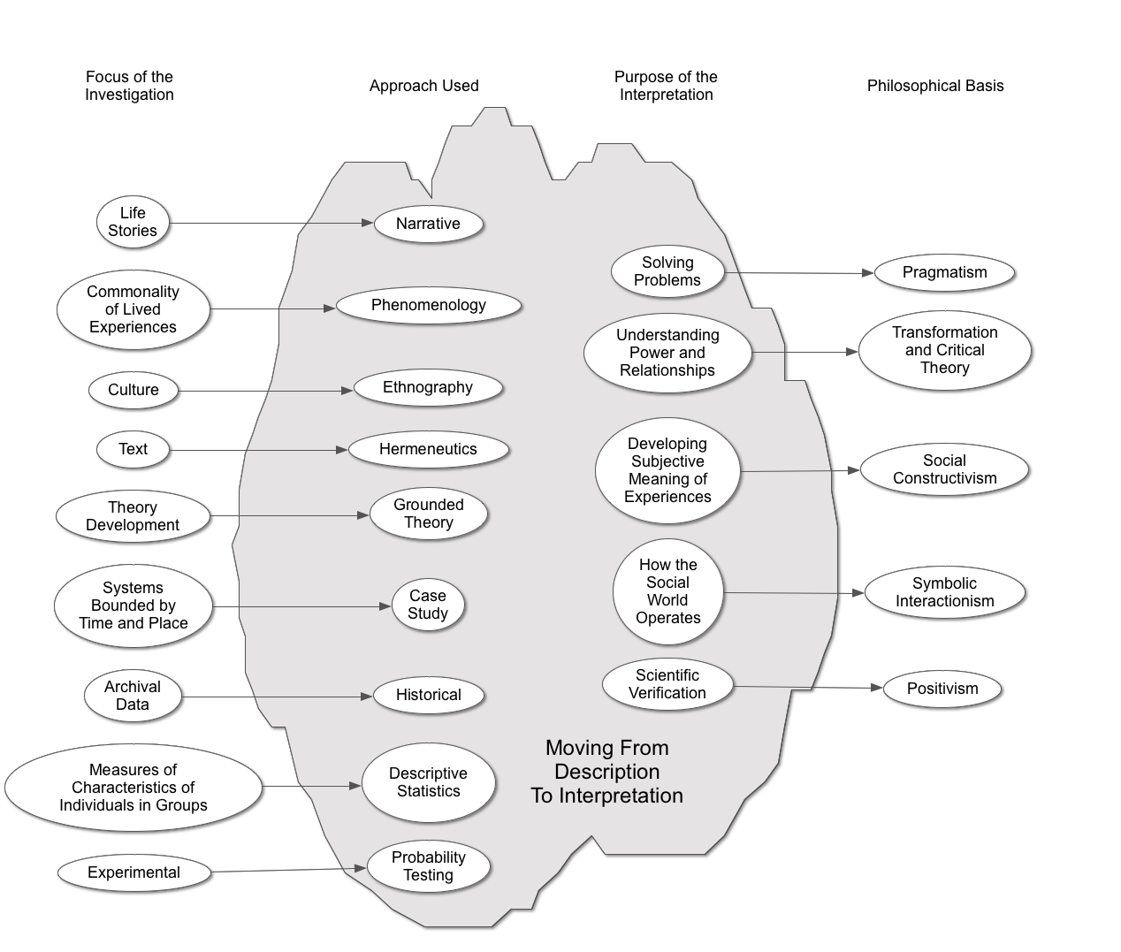
Coding

Slide 12
How to do this with paper
From the beginning keep a coding notebook
Transcribe all observations, interviews, and memos
During transcription identify natural separations
Set up the page so the right ¹ ⁄₃ is blank
Print transcripts double line spaced
First re-read your transcripts
Write quick memos as they come to mind
Do precoding

Slide 13
What to code?
In the beginning learning what does not need to be coded happens by coding everything
Some say (Strauss, Walcott, and others) that minutia can provide insight—code everything

Slide 14
Emerson’s General List of Questions as You Code
What are people doing? What are they trying to accomplish?
How, exactly, do they do this? What specific means and/or strategies do they use?
How do members talk about, characterize, and understand what is going on?
What assumptions are they making?
What do I see going on here?
What did I learn from these notes?
Why did I include them?

Slide 15
Saldaña adds …
What surprised me? (to track your assumptions)
What intrigued me? (to track your positionality)
What disturbed me? (to track the tensions within your value, attitude, and belief systems)
[remember Peshkin and subjectivity]

Slide 16
First Cycle Coding
Initial coding of the data corpus is done in a way that makes sense for your study.
Saldaña lists 24 possible first cycle coding methods in 7 categories.
Here are a few.

Slide 17
Attribute Coding Descriptive data about the setting
¹Well, if you are not familiar with the internet—there is a couple people who are just not comfortable with it—they are just not going to use it.
47 year old special education teacher.
Fifth week of Ed 555

Slide 18
Magnitude Coding Ordinal evaluation of responses
¹Well, if you are not familiar with the internet—there is a couple people who are just not comfortable with it—they are just not going to use it.
Attitude toward technology use: positive, neutral, negative
NEGATIVE

Slide 19
Subcoding Second order tags
¹Well, if you are not familiar with the internet—there is a couple people who are just not comfortable with it—they are just not going to use it.
Technology use-discomfort

Slide 20
Structural Coding Predetermined research topics
¹Well, if you are not familiar with the internet—there is a couple people who are just not comfortable with it—they are just not going to use it.
INTEREST IN USING TECHNOLOGY IN RESEARCH WORK
¹Well, if you are not familiar with the internet—there is a couple people who are just not comfortable with it—they are just not going to use it.

Slide 21
Descriptive Coding Nouns that describes topic
¹Well, if you are not familiar with the internet—there is a couple people who are just not comfortable with it—they are just not going to use it.
¹INTERNET

Slide 22
In Vivo Coding Respondents’ words
¹Well, if you are not familiar with the internet—there is a couple people who are just not comfortable with it—they are just not going to use it.
¹ “JUST NOT COMFORTABLE”

Slide 23
Process Coding Gerunds (actions)
¹Well, if you are not familiar with the internet—there is a couple people who are just not comfortable with it—they are just not going to use it.
¹ REFUSING
¹ WORRYING ABOUT SKILL

Slide 24
Emotion Coding Emotions recalled or inferred
¹Well, if you are not familiar with the internet—there is a couple people who are just not comfortable with it—they are just not going to use it.
¹ Stubbornness

Slide 25
Some First Cycle Coding Types
Attribute: Descriptive data about the setting
Magnitude: Ordinal evaluation of responses
Subcoding: Second order tags
Structural: Predetermined research topics
Descriptive: Nouns that describes topic
In Vivo: Respondents’ words
Process: Gerunds (actions)
Emotion: Emotions recalled or inferred

Slide 26
First Cycle Coding
You will probably need multiple methods simultaneously but try to carry whatever you choose all the way through.
You may need to do first cycle coding more than once.

Slide 27
Second Cycle Coding
Reorganization of first cycle codes in order to identify:
Categories
Themes
Theories
Elimination of marginal or redundant codes

Slide 28
Some Second Cycle Coding Types
Pattern: Identifying units of analysis (themes)
Focused: Identifying codes occurring most frequently
Axial: Identifying the dimensions of a category

Slide 29
Coding Approaches
Read everything and make notes of any potential themes that come to mind
Read until a possible theme appears and then follow it through all of the data
Code every sentence or piece of sentence and then recode into categories
Try to pick a single coding strategy and follow it through all the data

