Slide 1
Group Comparisons
What is the probability that group mean differences occurred by chance?
With Excel (or any statistics program) we computed p values to figure this out.
Then we focused on things to pay attention to while making these comparisons.

Slide 2
Confounding Variations of Group Mean Comparisons
Anticipating the direction of the change in mean scores (1 or 2-tailed tests)
The similarity of the samples (random error)
Random selection (sampling)
Sample size (practical significance)
Multiple simultaneous t-tests (ANOVA)

Slide 3
Research Design and Analysis

Slide 4
Research Design
Groups by Treatment (Independent Variable)
Data Gathering Events (Dependent Variable)

Slide 5
Did direct instruction improve students’ ability to recall math facts?
Independent ⇓
Data Gathering
Pre-Test
Post-Test
DI to 4th Grade Class
group data
group data
t-test, paired if possible

Slide 6
Do students who receive DI achieve better than those who do not?
Independent ⇓
Data Gathering
Test
DI to 4th Grade Class
group data
Non-DI to different 4th Grade Class
group data
t-test, independent samples

Slide 7
Do students who receive DI for math facts retain learning over the summer?
Independent ⇓
Data Gathering
Pre-Test
Post-Test
Post-Post-Test
DI to 4th Grade Class
group data
group data
group data
Repeated Measures

Slide 8
Which instructional strategy works better for teaching math facts?
Independent ⇓
Data Gathering
Test
DI
group data
Cooperative
group data
Inquiry
group data
Single Factor

Slide 9
Multiple Tests on the Same Data
The last two examples had 3 groups to be compared.
An unfortunate thing happens when multiple tests are done on the same data.

Slide 10
Multiple Group Comparisons
Number of Groups to be Compared in the Study | 2 | 3 | 4 | 5 | 6
Possible Group Comparisons | A-B | A-B A-C B-C | A-B A-C A-D B-C B-D C-D | A-B A-C A-D A-E B-C B-D B-E C-D C-E D-E | A-B C-D A-C C-E A-D C-F A-E D-E A-F D-F B-C E-F B-D B-E B-F
Total Possible Comparisons | 1 | 3 | 6 | 10 | 15

Slide 11
Being Wrong
Test Group Mean
5% (.05)
We say that occurring randomly less than 5% of the time is really unlikely so it is not random. But, that statement would be wrong 5% of the time.
Type 1 Error: Saying it is not random when it was.

Slide 12
Cumulative Error
If we test a data set for statistically significant differences we know we have the potential to be wrong 5% of the time. (Type I error)
If we test the same data set again the potential for a Type I error increases because we have given ourselves more opportunity to be wrong.
Type I error accumulates with multiple assessments of the same data.

Slide 13
Multiple Group Comparisons
Number of Groups to be Compared in the Study | 2 | 3 | 4 | 5 | 6
Possible Group Comparisons | A-B | A-B A-C B-C | A-B A-C A-D B-C B-D C-D | A-B A-C A-D A-E B-C B-D B-E C-D C-E D-E | A-B C-D A-C C-E A-D C-F A-E D-E A-F D-F B-C E-F B-D B-E B-F
Total Possible Comparisons | 1 | 3 | 6 | 10 | 15
Maximum Probability of a Type I Error | .05 | .15 | .30 | .50 | .75

Slide 14
Cumulative Error
Very quickly the probability of a Type I error gets unacceptably large.
One way to solve this is to reduce the alpha level because that reduces the probability of a Type I error for any given comparison. Accumulation of error would be slower.
But, you would also reduce the probability of discovering statistically significant differences.

Slide 15
The Way Out of This Problem
Remember that SD is the average distance of all of the scores from the mean?
We got to it by adding up the squared differences of each score.
The average of the squared differences is called the variance of the sample.
The SD is the square root of the variance so they are closely related.

Slide 16
Variance
Variance: The summary of the group is the mean. The distance that everyone is from the mean happened for unknown reasons. Variance is error in the model. If everyone had the same score there would be no error in the measurement.

Slide 17
Comparison of Three Sets of Scores
Within group variance (error within groups)
Figure out what the total variance is inside of all of the distributions.
The is called within group variance and it represents random error in the model.

Slide 18
Comparing Variance
Total variance
Within group variance (error within groups)
Then take all of the scores together and make a new distribution with its own mean and standard error.
This represents all of the random error plus the variance from the differences in the groups.
The differences in the groups is there because of the independent variable—your intervention.

Slide 19
Comparing Variance
Between group variance (impact of the intervention)
Subtract the within group variance from the total variance and you are left with the between group variance—how much of the variance is because of just the differences among the groups.

Slide 20
Comparing Variance
Between group variance (impact of the intervention)
What is left is the variance caused by the intervention.

Slide 21
The F Test
Divide the between group variance (impact of the intervention) by the within group variance (random error).
The result is compared to a sampling distribution of F to figure out the probability that your result is likely to happen by chance.

Slide 22
Analysis of Variance
Simplified, what the ANOVA does is look at a ratio
Between Group Variance (impact of the independent variable)
Within Group Variance (random error)

Slide 23
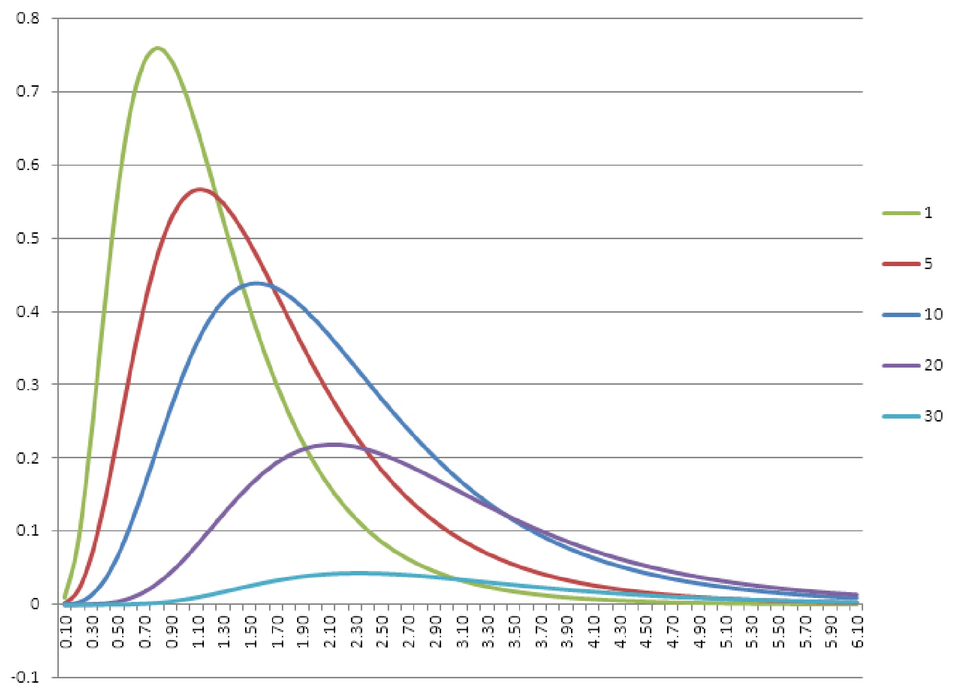
F Distributions
What is the probability that the f-test ratio could have occurred by chance?

Slide 24
ANOVA
Is the variance of these mean scores likely to have occurred by chance?
The problem is that if we know they did not appear by chance then which means are significantly different? The analysis only tells us there is a difference—not where.

Slide 25
Multiple Tests Simultaneously
When multiple (more than two) groups are to be compared on the same measure it is not appropriate to test each pair separately. The comparisons are not independent. (Type I error)
Analysis of Variance ANOVA
An ANOVA only tells if significant differences exist between at least two groups. It does not tell which group pairs are significant. A post hoc analysis is necessary to figure out which group differences are significant.

Slide 26
Download OWM Data from the site

Slide 27
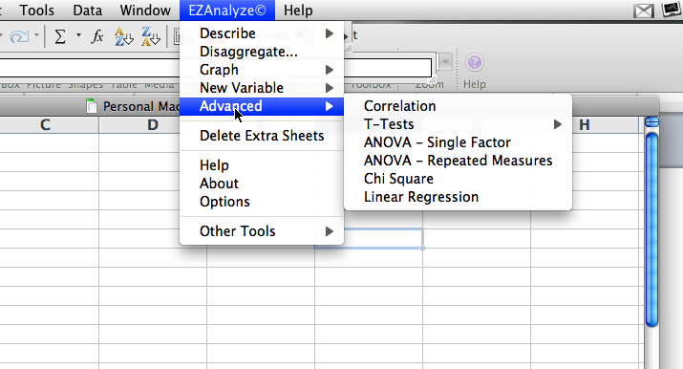
ANOVA in EZAnalyze
Single factor compares different groups on a single measure.
Repeated measures compares a single group on multiple uses of a single measure.

Slide 28
Single Factor ANOVA
A more conservative analysis because of the amount of error represented by the different groups.
For EZAnalyze there must be one variable that shows which group each individual is in (the independent variable).
Then there must be one variable the shows the measure for each individual (the dependent variable)

Slide 29
Repeated Measures ANOVA
A less conservative analysis because it is the same group every time.
For EZAnalyze there must be one variable for each iteration of the measure for each individual (the dependent variable)
There is no need for a grouping variable because it is the same group in all of the iterations of the measure.

Slide 30
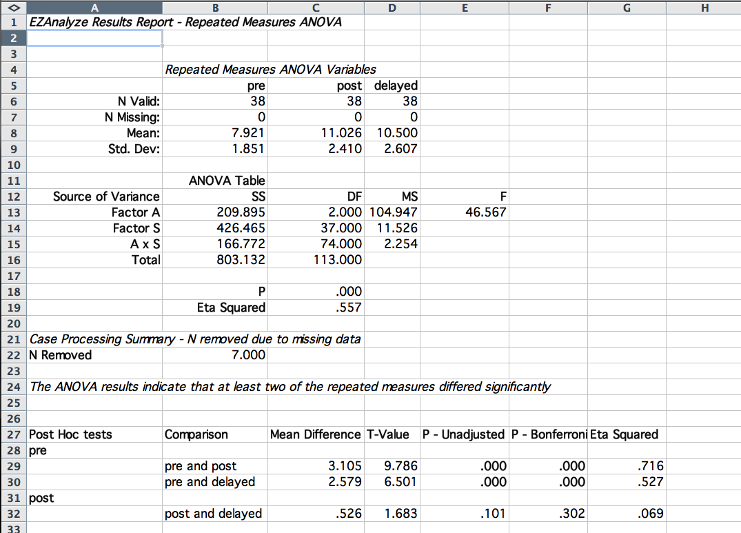
Significance of the whole ANOVA

Slide 31
ANOVA Post Hoc Tests
Use a Tukey’s HSD (honest significant difference) to compute multiple mean differences.
Accurate with groups of equal size.
Conservative with unequal variance.

Slide 32
Post hoc test results

Slide 33
ANOVA Practical Significance
ANOVAs have the same problem as comparison of two group means.
Large sample sizes make significance appear more easily.
Practical significance is measure by asking:
How much of the total variance is represented by the between group variance?
How much of the variance is explained by the intervention?

Slide 34
Eta Squared (η²)
Total variance
Between group variance (impact of the intervention)
Random error
Eta Squared is a ratio:
The larger the effect, the closer eta squared is to one.
Effect Variance (impact of the intervention)
Total Variance (impact of the intervention plus random error)

Slide 35
Interpretation: .01 small
.06 medium
.14 large
.50 very large

Slide 36
Cohen’s d is better with two group comparisons

Slide 37
APA ANOVA Table

Slide 38
Descriptive Paragraph
Pretest, posttest, and 2 month delayed assessment scores for 38 students were compared using repeated measures ANOVA analysis (Table 1). Post and delayed scores were statistically significantly higher than pretest scores (p < .001). No statistically significant difference appeared between posttest and delayed scores.

Slide 39
Things to remember…
You have to figure out which t-test to use by judging the similarity of the groups.
Decide if your comparison should be one-tailed or two.
If you are comparing more than two groups simultaneously you have to use an ANOVA not a t-test.
Compute effect sizes, particularly if the groups are large.
Be random when you can.

Slide 40
ANOVA Practice
Download the Reading Attitude data from the Excel tab.
Determine the correct analysis and do it.
Build an APA table.
Write a descriptive paragraph for the table.
Send me a Word document with the table and the paragraph.

