Slide 1
The Structure of Research Reports

Slide 7
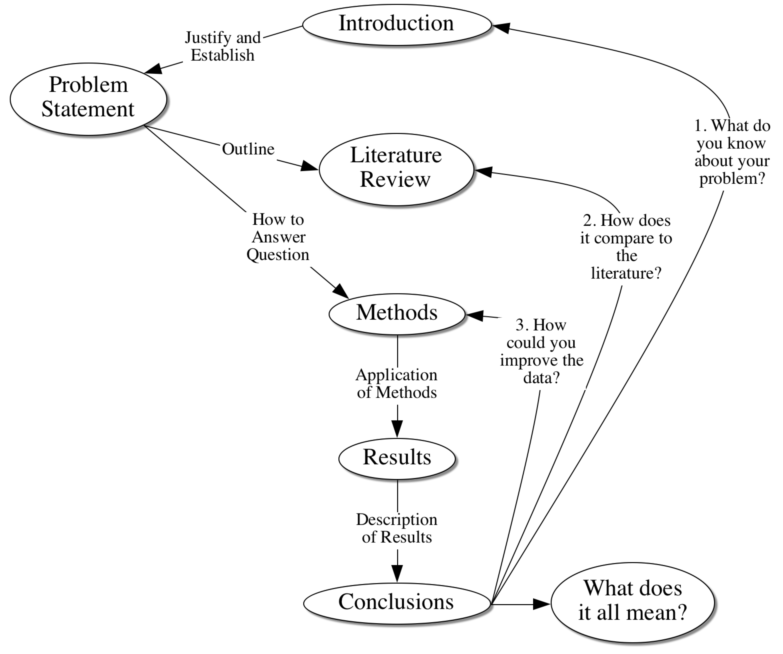

Slide 9
Research Proposal

