Slide 1
Lit Reviews and Library

Slide 2
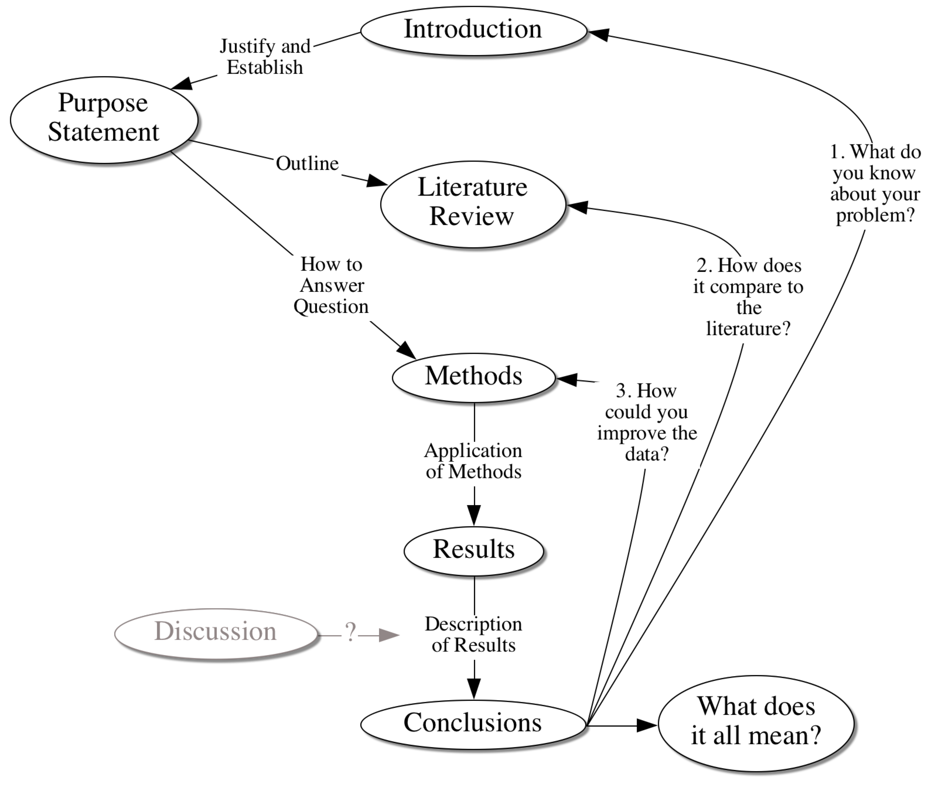

Slide 3
Doing a Literature Review
Step 1: Pin a poster of your purpose statement up over your computer.
Step 2: Make an outline based on the purpose statement. Nothing else.

Slide 4
Doing a Literature Review
Step 1: Pin a poster of your purpose statement up over your computer.
Step 2: Make an outline based on the problem statement. Nothing else.
Step 3: Go find literature.
Step 4: Write short reviews of everything you read. Ok, you will not do this but it is a good idea.
Step 5: Organize your chapter based on the outline.

Slide 5
Doing a Literature Review
Step 1: Pin a poster of your purpose statement up over your computer.
Step 2: Make an outline based on the problem statement. Nothing else.
Step 3: Go find literature.
Step 4: Write short reviews of everything you read. Ok, you won’t do this but it is a good idea.
Step 5: Organize your chapter based on the outline.

Slide 6
Literature Reviews
A literature review is a synthesis of the literature on a topic. To create the synthesis, one must first interpret and evaluate individual pieces of literature. Then, the ideas and information they contain must be integrated and restated in order to create a new, original written work. (p. 1)
Pan, M. L. (2004). Preparing literature reviews (2nd ed.). Glendale, CA, Pyrczak Publishing.

Slide 7
Why Do Literature Reviews
You get really tired of listening to people say stuff that they are clearly making up.
A lit review is not a perfunctory assignment. It is a primary skill that all researchers must be able to apply in varying contexts for varying purposes—over and over again.

Slide 8
Purposes of a Literature Review
Demonstrate knowledge of the field
Justify the reason for the research
Establish a theoretical foundation
Establish a methodological rationale
Provide a basis for reflection on the importance of findings

Slide 9
What This Means
You are doing original research.
To demonstrate that it is original research you have to know what has been previously published on your topic.
This is one of the many reasons that your research topic must be incredibly focused.

Slide 10
Guiding Principle of Library Research
Library research is best done with a Guinness and a bag of Kettle’s Honey Dijon potato chips.

Slide 11
Primary vs. Secondary
A primary source is a report of research in which the author has gathered and analyzed data.
A secondary source is a report in which an author is reporting on other people’s primary research. (Like your lit review)
Be cautious of (but still use) secondary sources.
Books are often secondary sources.

Slide 12
What To Read
If what you are reading is not supported by other credible research then you probably should not be reading it.
Primary sources first.
Secondary sources if they are credible reviews of primary sources.
  Other literature reviews
  Meta-Analyses
  Books are often secondary sources

Slide 13
Using Search Terms
Start specific and then move to more general until you find what you need.
library.up.edu. (Summit)
When you find something related to your topic check the search terms (“Subjects”)

Slide 14
Using Published Literature Reviews
Handbook of Research on … (sorry, you probably have to go to the physical library)
American Educational Research Journal
Review of Educational Research
Journal of Educational Research
Dissertations

Slide 15
Meta-Analyses
Comparing effect sizes of multiple studies
Making inferences based on those comparisons
Lists all of the original studies that are included
Functions as primary research
Glass, G. V., McGaw, B., & Smith, M. L. (1981). Meta-analysis in social research. Beverly Hills, CA: Sage.

Slide 16
Reference List
Colley, K. M. (1999). Coming to know a school culture. (Unpublished doctoral dissertation). Virginia Polytechnic Institute and State University, Blacksburg, VA.
DeBruyne, J. W. (2001). A study to identify the factors responsible for job dissatisfaction and low teacher morale. Research paper. University of Wisconsin-Stout, Menomonie, WI.
Hinde, E. R. (2004). School culture and change: An examination of the effects of school culture on the process of change. Essays in Education, 12.
Jarzabkowski, L. M. (2002). The social dimensions of teacher collegiality. Journal of Educational Enquiry, 3(2), 1-20.
Mackenzie, N. (2007). Teacher morale: More complex than we think? Australian Educational Researcher, 34(1), 89-104.
Stolp, S. (1994). Leadership for school culture. ERIC Digest, 91, 1995-1991.

Slide 17
Finding Journals—On the Library Page
Using “UP Library Search.”
Enter your search terms and type the word “periodicals” at the end.

Slide 18
Finding Journals
Look in the reference list of ANY article related to your topic.
Use Summit
  Go to library.up.edu (and bookmark the site)
Look for journals that are likely to have extensive lit reviews

Slide 19
What Does Peer-Reviewed Mean?
You want to publish an article.
A peer is someone who either knows about your topic or knows how research should be done on your topic—preferably both.
Peer-reviewed means that your article is more credible because people who should know what they are talking about have said it is worthy.
Some journals are better at peer-review than others.

Slide 20
The Cautious Case for Books
Edited
  Compilation of articles
  Not necessarily peer reviewed
Single Author
  Reviews of research (own and other’s)
  Long publication cycle
  Not necessarily peer reviewed
Text Books
  Not necessarily peer reviewed

Slide 21
American Educational Research Association (AERA)
The largest educational research organization on the planet
The annual conference has 10 to 15 thousand participants
Think about the cycle of publication for researchers
www.aera.net

Slide 22
American Educational Research Association (AERA)
And, at long last…!
The Online Paper Repository
  http://www.aera.net/Publications/tabid/10067/Default.aspx
  A growingly complete repository for all of the papers presented

Slide 23
Google Scholar
WorldCat
Search results
  Recent Articles
  Direct Link
  All versions
  Citations
  Related articles
UP resources

Slide 24
Reference Extractions
First and foremost
  get good at typing references cold
Look for citation links
  database services (EBSCO—not ERIC)
  Google Scholar
RefWorks (owned by UP)
Commercial reference software (e.g., EndNote)
Zotero

Slide 25
How To Read
Read new to old
Read to determine if the article is relevant
Skim the reference list
Read for foundational studies
Read for findings
Read for the quality of the study
Carefully read complete articles that have risen to the top

Slide 26
How To Analyze
Develop rituals for tracking papers and notes
Distinguish between assertion and evidence
Identify patterns or trends across papers
Group writings into camps
Identify methodological strengths
Pay attention to how other authors have organized their lit reviews

Slide 27
How To Write
Know why you are writing the review
Outline your argument
Trace a path in your argument
Attach papers or camps to the path
Write in APA style
Describe the studies based on your outline looking for differences among studies
Account for outliers
Write a summary
Write a conclusion

Slide 28
Literature Reviews
Researchers write literature reviews. It is part of the job.
Keep yourself out of the lit review.
A reader should be able to trace every statement back to an author.
Try moving the citation as early in the sentence as possible.
In general, the best literature reviews are written by authors who start by knowing very little about the topics they are covering.

Slide 29
The deep neurological impact of cultural acquisition in brain development and the brain’s changes over time may be at least in part based on culture or tasks assigned (Park & Huang, 2010). Further, culture can attune people’s abilities and perceptions to reflect cultural expectations or interests (Freeman, Rule, & Ambady, 2009).
Park and Huang (2010) assert that the deep neurological impact of cultural acquisition in brain development and the brain’s changes over time may be at least in part based on culture or tasks assigned. In a 2009 study, Freeman, Rule, and Ambady found that culture can attune people’s abilities and perceptions to reflect cultural expectations or interests.

Slide 30
A Brief Word About Direct Quotations
Don’t
“Direct quotations are best avoided whenever possible. Using your own words by paraphrasing will better demonstrate your understanding and will allow you to emphasize the ways in which the ideas contribute to your paper’s main argument.” (Walden U. Online Writing Center)
Continuity, Smoothness, Economy, Clarity (Sections 3.05 – 3.09)

