Slide 1
Developing a Leadership Model
BUS512 EXERCISE

Slide 2
Steps
Pick a person who you admire for their values and goals, who you would follow (or you have followed).
Research, reflect and write down:
Why you would/did you follow?
Their core values, assumptions, beliefs and expectations
How did you know that these were their core values, assumptions, beliefs and expectations?
Their most positive behavioral tendencies and habits
How you hope they make you feel.
What you hoped you would get/achieve from following them
Reflect-upon this, and our readings and your experiences and draw a model of how you imagine this person leads.

Slide 3
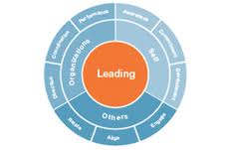
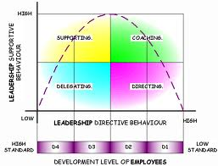
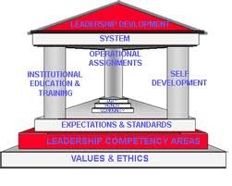
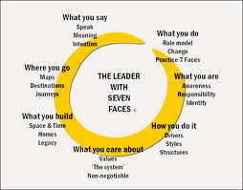

Slide 4
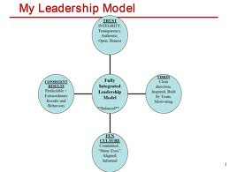
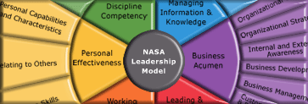
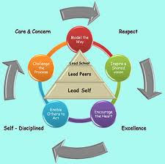
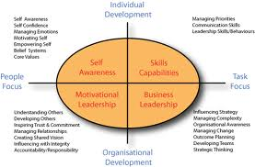

Slide 5
